Slide 1

Spiritual Terms Evaluation

Slide 2
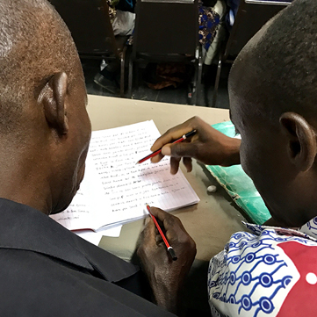
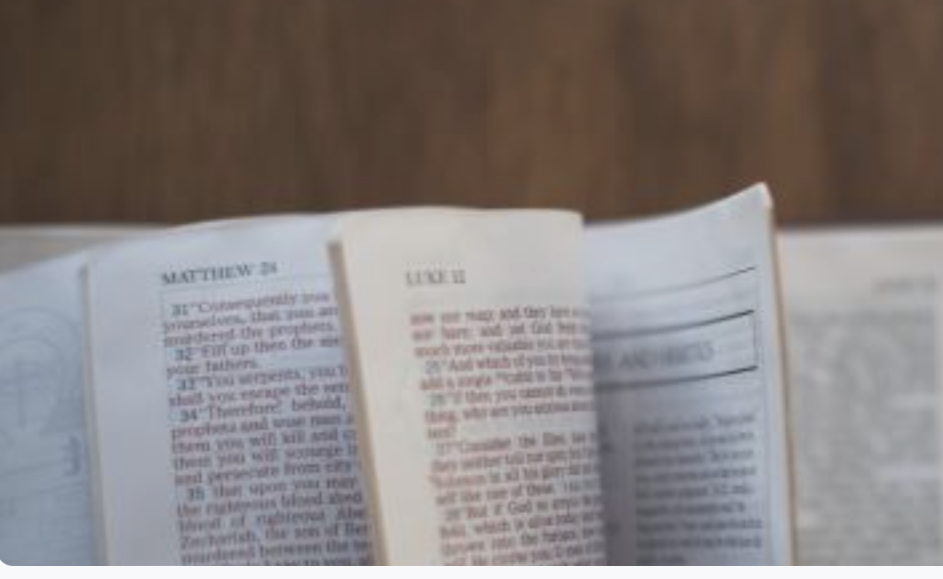
In Step 7, key words were chosen for each chapter.
Now terms will be evaluated across the whole New Testament.

Slide 3
What kinds of terms?
Abstract meaning
Spiritual
meaning
tree
adoption
flesh

Slide 4
?
Why check words across the whole New Testament?
Different translators
Same
words?

Slide 5
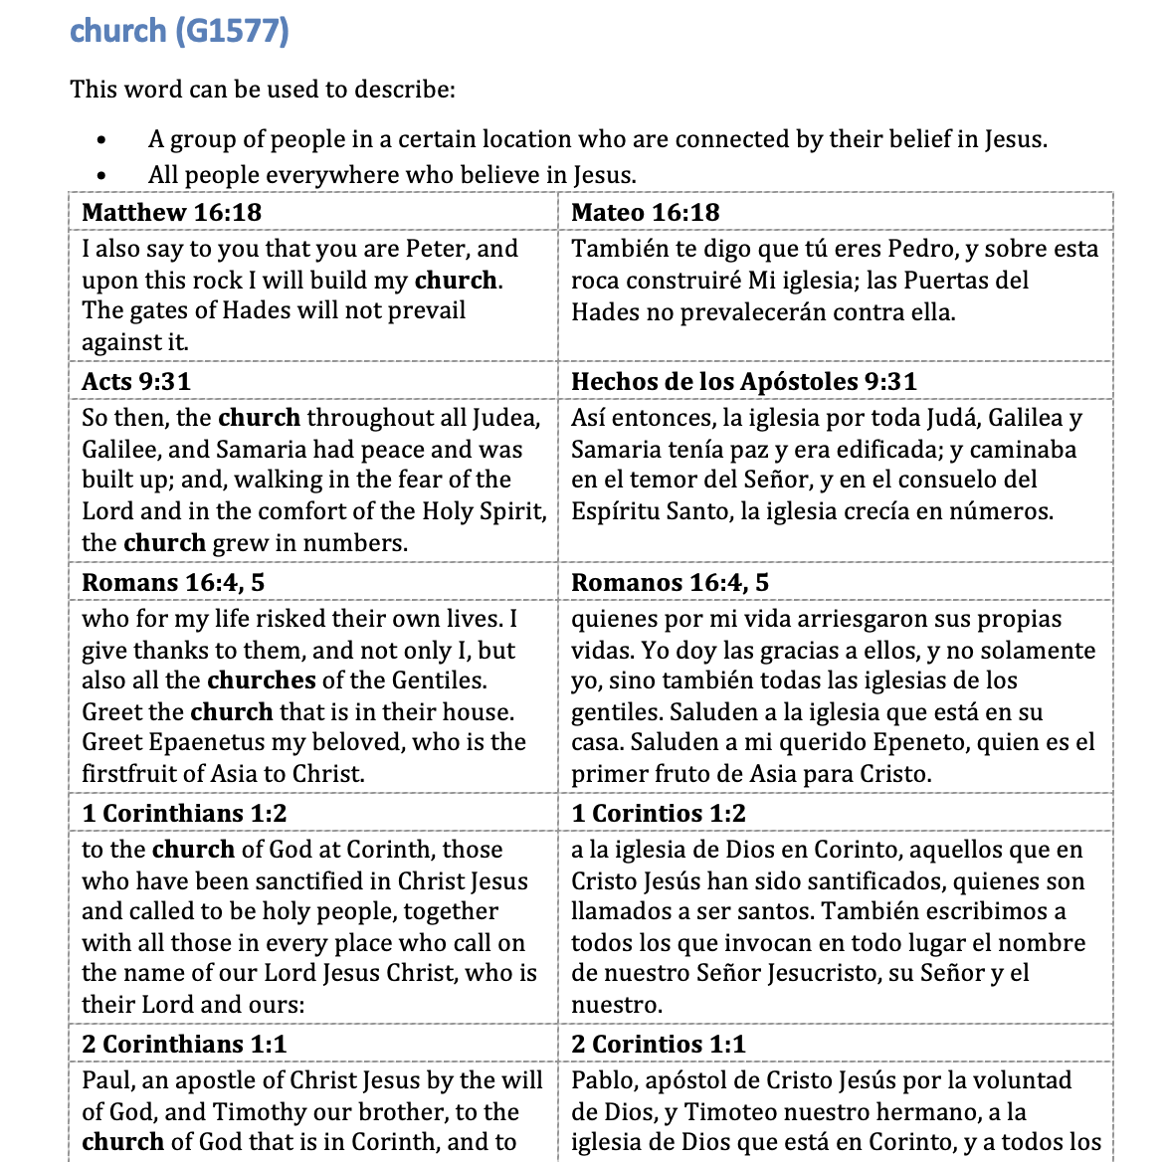



Slide 6
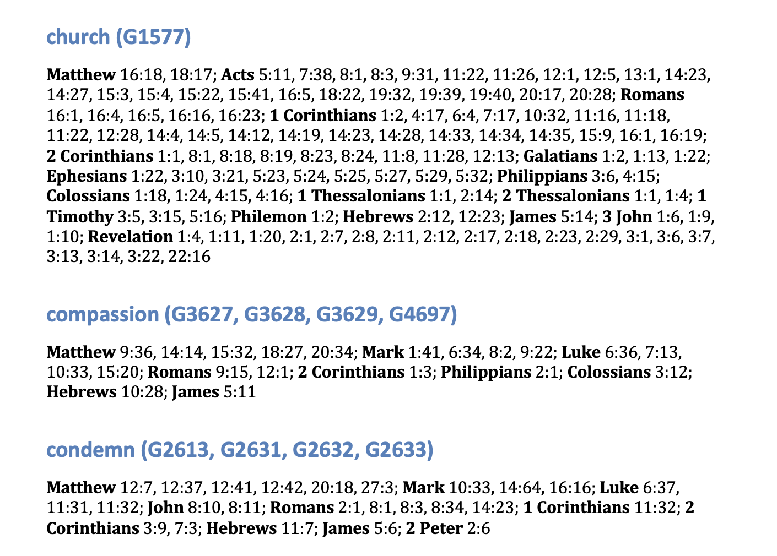

Slide 7
Try it

Slide 8
?
Consistency?
Correct meanings?
Changes?

Slide 9


